Slide 1
C++ Course
Games Academy Berlin 2015-05-22 - Day 4
Benjamin Nitschke - Delta Engine

Slide 2
Recap of Day 1
C++ Overview: Pros & Cons, IDEs, Setup, Structure
Test Driven Development
C++ Features
Objects
Data Hiding
Encapsulation
Inheritance
Polymorphism
Pointers
TextAdventure console game
Notes:
Quick recap of Day 1

Slide 3
Recap of Day 2
OpenGL
via GLFW
Window handling
Immediate drawing
Loading and drawing textures
Sprites
Visual Tests
Creating classes and functionality step by step
SpaceInvaders game
Notes:
Ask if there are any questions from what was discussed so far

Slide 4
Recap of Day 3
Reusable Common Static Library
CppGameEngine
OpenGL C++ 3D Programming
Vertex Formats
Custom Structs and Operators
Project and View Matrices
3D Textures, Blending, Lighting
3D Movement & Rotation
FPS Game
Notes:
Ask if there are any questions from what was discussed so far

Slide 5
Getting Unreal Engine
https://www.unrealengine.com/
Create a free account
Download & Install Epic Games Launcher
Login again in the installer
Finally choose Unreal Engine 4
Install Unreal Engine 4.7.6 on the top left
Agree Eula
You need at least 11GB free space

Slide 6
Unreal Engine C++ Source Code
Click on your account in the top right
Select Manage Account, which sends you to
https://www.unrealengine.com/dashboard
Click on “linking your Github account” for details
When done you can download or fork
https://github.com/EpicGames/UnrealEngine
Note: You don’t need the source code to work with Unreal Engine 4, but since we want to learn C++ it is a good idea to look how professionals do it!

Slide 7
Unreal Engine C++ Source Code
Click on your account in the top right
Select Manage Account, which sends you to
https://www.unrealengine.com/dashboard
Click on “linking your Github account” for details
When done you can download or fork
https://github.com/EpicGames/UnrealEngine
Note: You don’t need the source code to work with Unreal Engine 4, but since we want to learn C++ it is a good idea to look how professionals do it!

Slide 8
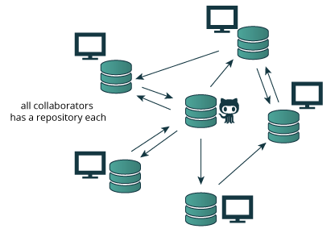

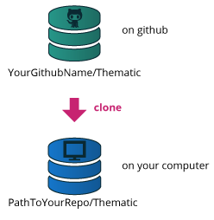
GitHub primer
Notes:
Since downloading unreal engine will take some time, we can talk about other topics (or start looking at the source code)
Only if needed.
http://thepilcrow.net/explaining-basic-concepts-git-and-github/
https://windows.github.com/
https://help.github.com/articles/set-up-git/
https://help.github.com/articles/fork-a-repo/

Slide 9
Let’s look at the Unreal Source Code
#include "Platform.h" // Set up base types, etc for the platform
#include "Build.h" // Build options.
#include "ProfilingDebugging/UMemoryDefines.h" // Memory build options.
#include "CoreMiscDefines.h" // Misc defines and enumerations
#include "Containers/ContainersFwd.h"
#include "Timespan.h" // Time span definition
#include "DateTime.h" // Date and time handling
#include "PlatformIncludes.h" // Include the main and misc platform headers
#include "PlatformFilemanager.h" // Platform file manager.
#include "AssertionMacros.h" // Various assertion macros
#include "UObject/UnrealNames.h" // EName definition.
#include "OutputDevice.h" // Output devices, logf, debugf, etc
#include "NumericLimits.h" // Numeric limits
#include "UnrealMathUtility.h" // FMath
...
Notes:
This makes no sense on slides, we will go through the important and interesting topics we discussed in the last two days like type definitions, how they handle pointers, some examples like UObject, JSON handling, etc.

Slide 10
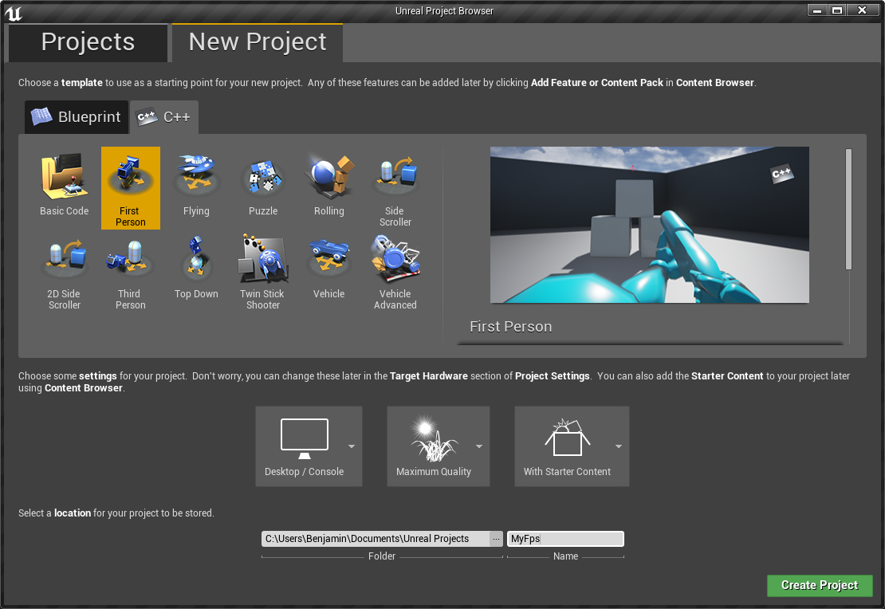
Create a C++ Unreal Engine project
Notes:
Name it “UnrealFps”

Slide 11
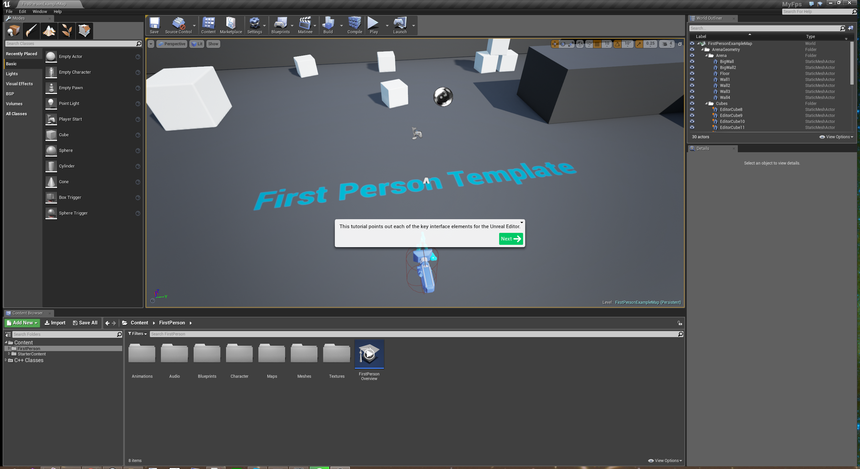
Unreal Editor Tour
Notes:
We are not so interesting in the editor, it is outside the scope of this course, but the basics are needed to navigate around and get to the actual code editing and testing.
After the Editor tutorial go through the C++ First Person Tutorial as well. Also click on interesting things like the Character class, which is one we want to modify today.
Details at: https://wiki.unrealengine.com/First_Person_Shooter_C%2B%2B_Tutorial

Slide 12
Adding C++ Files
File -> Add Code To Project
Create Actor Class
Name it “MyActor”
Inspect MyActor.h and MyActor.cpp
Inspect other classes in MyFps project
MyFps, MyFpsCharacter, MyFpsGameMode, MyFpsHUD, MyFpsProjectile
A ton of .ini files to customize settings
Notes:
After playing around in the editor and shooting boxes with our little FPS template, let’s do some coding.
This is directly from the Add C++ File Tutorial. Same steps are also described here:
https://docs.unrealengine.com/latest/INT/Programming/QuickStart/2/index.html

Slide 13
Say Hello
Modify MyFpsGameMode.cpp (and the .h)
#include "MyFps.h" ... #include "Engine.h" AMyFpsGameMode::AMyFpsGameMode(const FObjectInitializer& ObjectInitializer) : Super(ObjectInitializer) { //... } void AMyFpsGameMode::StartPlay() { if (GEngine) GEngine->AddOnScreenDebugMessage(-1, 5.f, FColor::White, TEXT("Welcome to our game!")); }
Notes:
Notice the coding guidelines in Unreal Engine, they are different from what we have done so far. Better keep things as close as possible to their standards, for your own code you are free to do whatever you like, but your team should have clear guidelines.
We need to define StartPlay in the header file too, which comes from AGameMode, take a look.
GEngine is defined in Engine.h, which is not good coding practice to have static global variables anyway, but there is no testing in the engine anyway and most game engines do not have the cleanest code ..
Check out parameters of AddOnScreenDebugMessage and look at FColor too.

Slide 14
Rotate our MyActor around
Modify MyActor.cpp and compile the project again
// Called every frame
void AMyActor::Tick( float DeltaTime )
{
Super::Tick( DeltaTime );
FRotator newRotation = GetActorRotation();
newRotation.Yaw += DeltaTime * 20;
SetActorRotation(newRotation);
}
Notes:
Notice the coding guidelines in Unreal Engine, they are different from what we have done so far. Better keep things as close as possible to their standards, for your own code you are free to do whatever you like, but your team should have clear guidelines.
We need to define StartPlay in the header file too, which comes from AGameMode, take a look.
GEngine is defined in Engine.h, which is not good coding practice to have static global variables anyway, but there is no testing in the engine anyway and most game engines do not have the cleanest code ..

Slide 15
Making MyActor visible
Go back to the Unreal Editor
Locate MyActor in the Content Browser (C++ Classes)
Drag MyActor into the scene in the center
Name the newly created instance “MyActorInstance”
Add component (green button)
Cube (or whatever you like)
Make sure the object is visible in front of the player
Play around with location, rotation, scale
Compile from the Editor to get all changes available there
Press play to see the Cube spinning around
Notes:
Notice we can also jump on the MyActor cube and we will rotate around as well :)

Slide 16
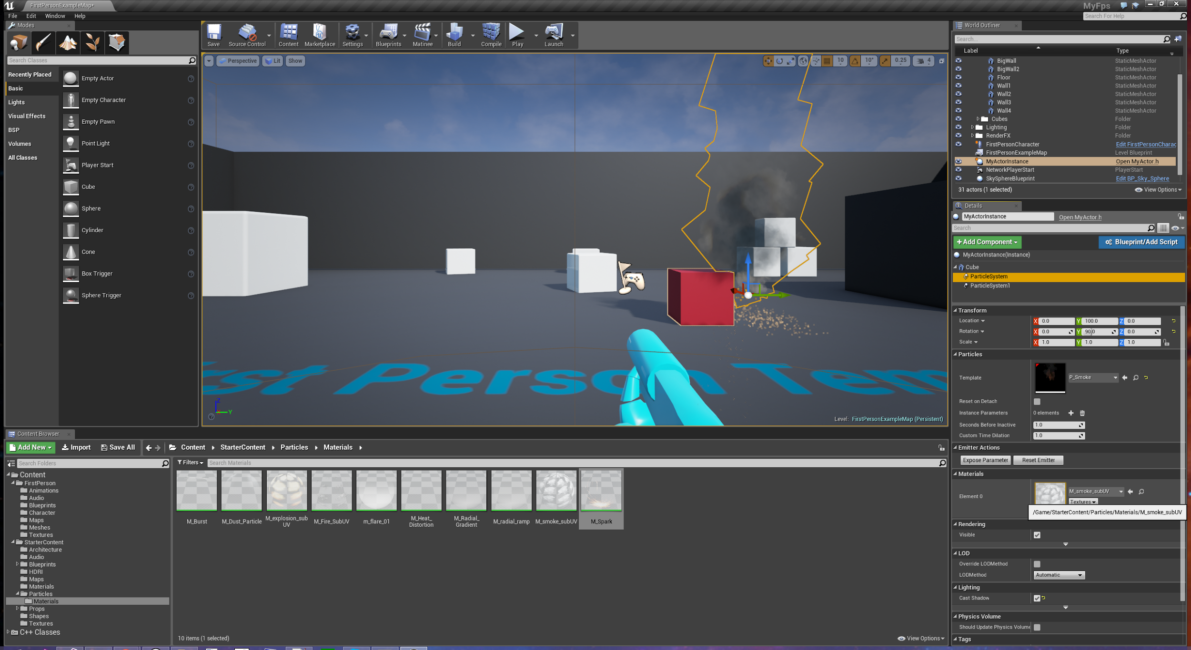
Play around, add particles, etc.

Slide 17
C++ Engine Architeture
With Unreal as an example
https://docs.unrealengine.com/latest/INT/Programming/UnrealArchitecture/Reference/index.html
Not everything from C++11 is supported, but if you use the unreal smart pointers and read this, you are fine: https://docs.unrealengine.com/latest/INT/Programming/Development/CodingStandard/index.html
Notes:
Interesting parts:
https://docs.unrealengine.com/latest/INT/Programming/UnrealArchitecture/StringHandling/index.html
https://docs.unrealengine.com/latest/INT/Programming/UnrealArchitecture/SmartPointerLibrary/index.html

Slide 18
Unreal Source Code Reviews
http://www.viva64.com/en/b/0249/
https://willyg302.wordpress.com/2014/04/06/unreal-engine-4-review/
http://www.tomlooman.com/getting-started-with-unreal-engine-4/
http://www.amazon.com/Learning-C-Creating-Games-UE4/dp/1784396575

Slide 19
Integrating Lua via C into Unreal
http://benjaminnitschke.com/post/2009/03/28/Making-Lua-run-on-the-Xbox-360-and-PS3-(native-code).aspx
Not the same anymore, but there is even better Lua integration into the Blueprint Editor now:
https://forums.unrealengine.com/showthread.php?3958-Scripting-Language-extensions-via-plugins

Slide 20
More details
FPS parts: https://wiki.unrealengine.com/First_Person_Shooter_C%2B%2B_Tutorial
Actor: https://docs.unrealengine.com/latest/INT/API/Runtime/Engine/GameFramework/AActor/index.html
More tutorials: https://docs.unrealengine.com/latest/INT/Programming/Tutorials/index.html
Notes:
Go through the tutorial for more details about Unreal works and how we write C++ code.

Slide 21
Questions?
All code and these slides are available at:
https://github.com/BenjaminNitschke/CppCourse/Day4

Slide 22
Unreal Engine Development Links
https://www.unrealengine.com/blog/introduction-to-c
https://docs.unrealengine.com/latest/INT/Programming/QuickStart/index.html
https://wiki.unrealengine.com/First_Person_Shooter_C%2B%2B_Tutorial
https://www.youtube.com/watch?v=VxvahnKYB8E
https://www.youtube.com/watch?v=hYuOI9pwiaE
https://docs.unrealengine.com/latest/INT/
https://github.com/EpicGames/UnrealEngine
Notes:
Also see C++ links from yesterday

